Slide 1
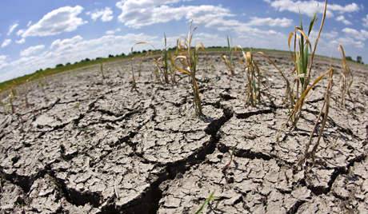
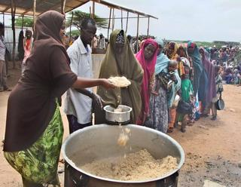
Africa’s Drought and Famine problem

Slide 2
What is Drought?
extended period of time when a region notes a significant decrease in its water supply whether surface or underground water.
A drought can last for months or years, or may be declared after as few as 15 days.

Slide 3
Facts about Africa’s Drought
Mostly in the Horn of Africa, where months of dry weather classified as worst in 60 years
Kenyan government officials have blamed climate change on a recurrence of droughts
Officials at UNICEF estimate that numbers of malnourished children in the Horn of Africa countries has increased by 50 percent over levels previously recorded.
Famine is tied to increased drought

Slide 5
More than a million hungry in Kenya drought - Horn of Africa
http://www.youtube.com/watch?v=Re5xXy62LVU

Slide 6
What is Famine?
famine is a widespread scarcity of food, caused by crop failure, population unbalance, or government policies.

Slide 7
Facts about Africa’s Famine
239 million people in sub-Saharan Africa were hungry/undernourished in 2010
World Food Program estimates that 11.5 million people in Somalia, Ethiopia, Kenya, Djibouti and Uganda urgently need food aid
The United Nations announces that 260,000 people in Somalia died from the famine between October 2010-April 2012.

Slide 8
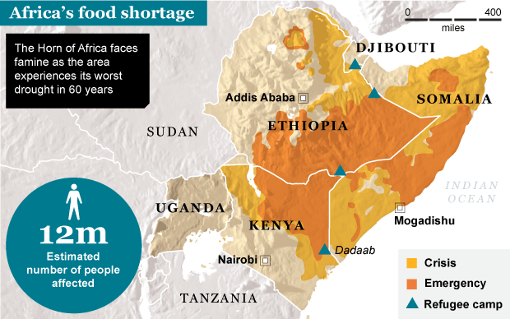
Famine in East Africa
http://www.youtube.com/watch?v=Qx9P1RDpgeE

